Slide 1



www.ed.ac.uk/platform-one

Slide 2
Description
Platform One is a meeting place, a community place, a discussion place. It is a platform of possibilities. Its aim is to provide a single online location where students, alumni, staff and volunteers can share, interact and advise.
We have called it Platform One because it is a platform and we are a single community.

Slide 3
Language
It is a place and not a piece of software.
It is about people and not users.
It is authentic and not manufactured.
It is about conversations and not functionality.
It is about possibilities not certainties.
We won’t be offering demos, we’ll simply show people around.

Slide 4
Visual Identity
The visual identity is based around individuals and their stories.
We want to capture and foreground the experiences of real alumni, staff and volunteers whose lives and careers are varied, unexpected, twisty, turny and true.
We want to present equally authentic students, who are equal parts ambitious, cautious, unrealistic, wise, reckless, informed and confused.

Slide 5

Zoe

Slide 6

Jonathan

Slide 7
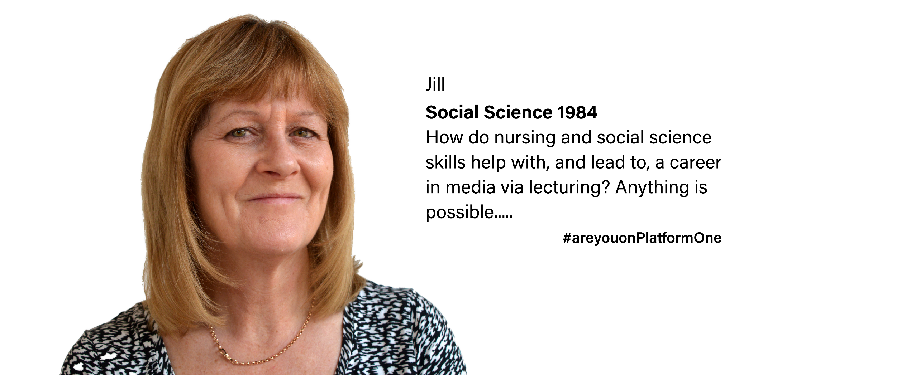
Jill

Slide 8
Support
Platform One offers an opportunity for our community to connect with each other and benefit from sharing knowledge, insight and experience.
One to One is the name we have given to structured individual support.
At the core is a belief that our community wants to help each other.

Slide 9
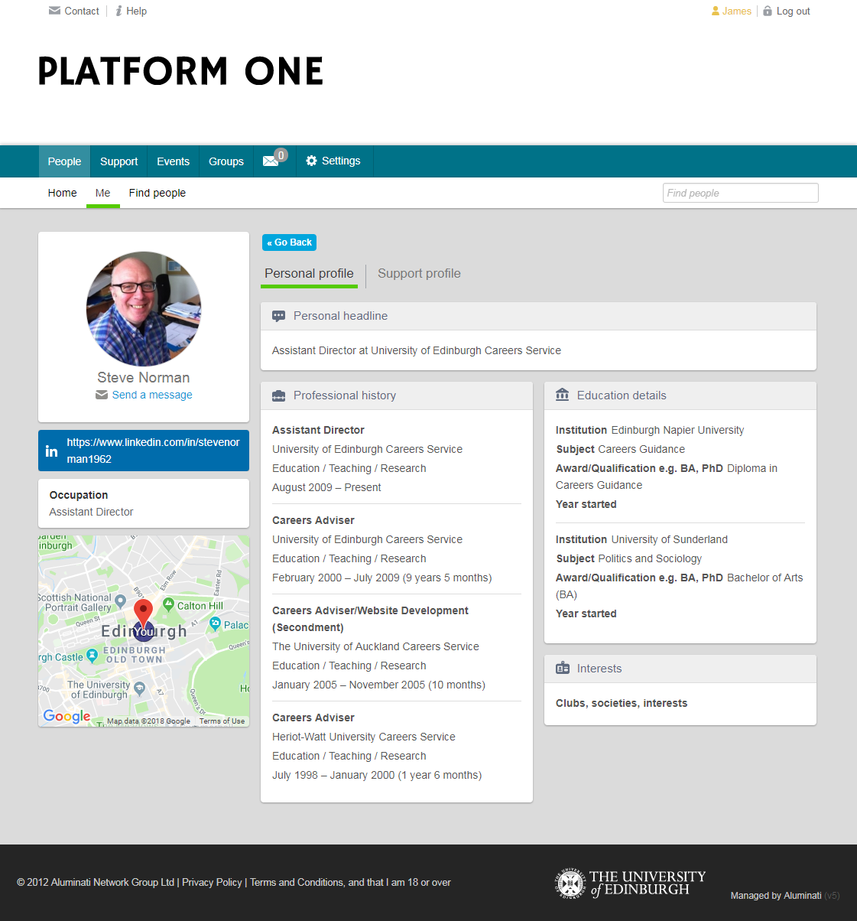
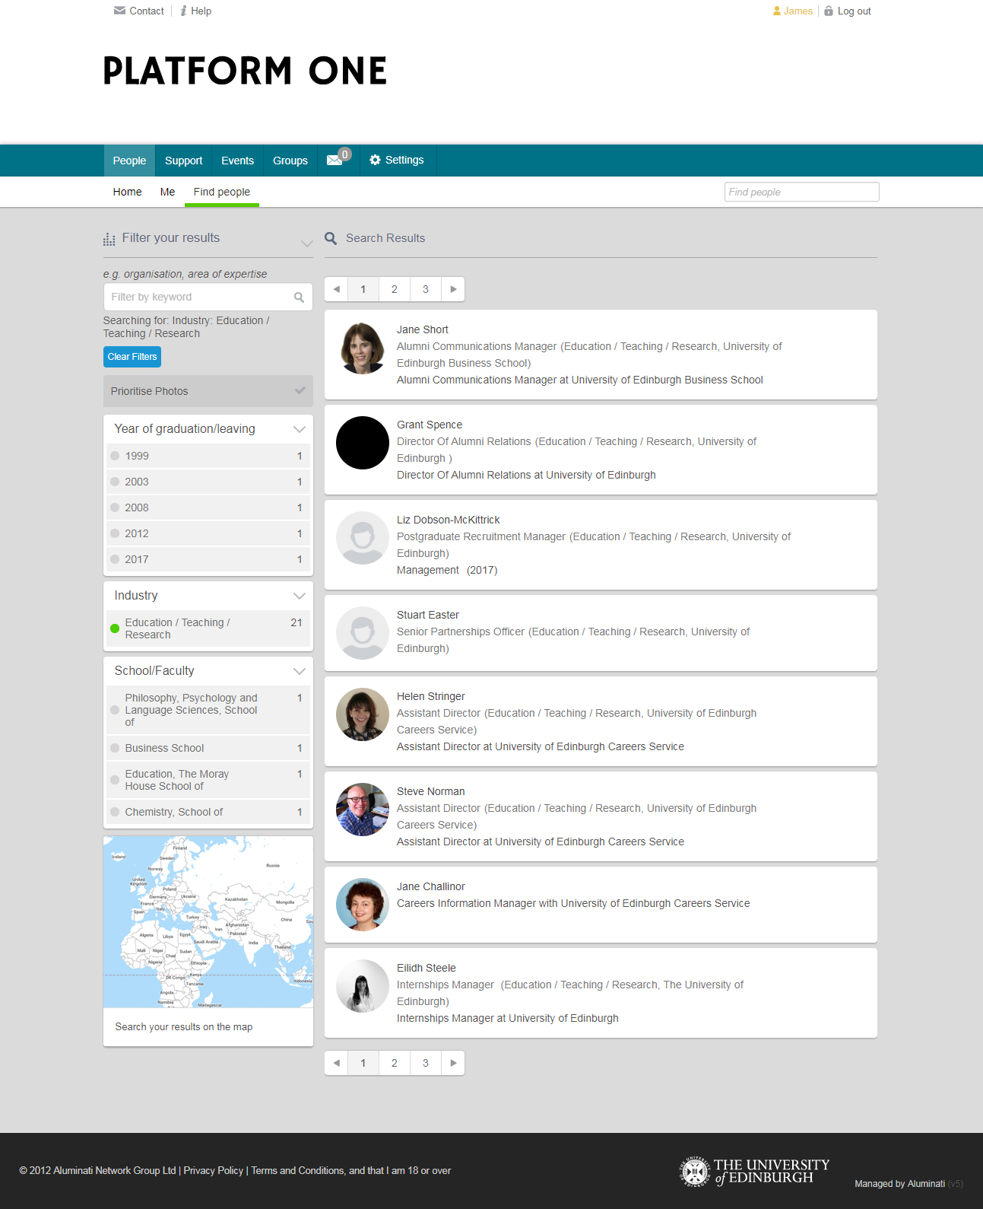
Screenshots

Slide 10
#areyouonPlatformOne
www.ed.ac.uk/platform-one
platform-one@ed.ac.uk

